Slide 1

CO#2 – Relational Model Session#8: Session Topic: Relational Model: concepts, constraints, schemas Database Management and Systems (Course code:)

Slide 2

Relational Model (RM) represents the database as a collection of relations. A relation is nothing but a table of values. Every row in the table represents a collection of related data values. These rows in the table denote a real-world entity or relationship.
The table name and column names are helpful to interpret the meaning of values in each row. The data are represented as a set of relations. In the relational model, data are stored as tables. However, the physical storage of the data is independent of the way the data are logically organized.

Slide 3
The relational model represents the database as a collection of relations. A relation is nothing but a table of values. Every row in the table represents a collection of related data values. These rows in the table denote a real- world entity or relationship.
The table name and column names are helpful to interpret the meaning of values in each row. The data are represented as a set of relations. In the relational model, data are stored as tables. However, the physical storage of
the data is independent of the way the data are logically
organized.
3

Slide 4




Data need to be represented as a collection of relations
Each relation should be depicted clearly in the table
Rows should contain data about instances of an entity
Columns must contain data about attributes of the entity
Cells of the table should hold a single value
Each column should be given a unique name
No two rows can be identical
The values of an attribute should be from the same domain
4

Slide 5








1. Tables – In the Relational model the, relations are saved in the table format. It is stored along with its entities. A table consists of rows and columns. Rows represent records and columns represent attributes.
Attribute: Each column in a Table are called attribute. Attributes are the properties which define a relation. e.g., Student_Rollno, NAME,etc.
Tuple – It is nothing but a single row of a table, which contains a single record.
Relation Schema: A relation schema represents the name of the relation with its attributes.
Degree: The total number of attributes which in the relation is called
the degree of the relation.
6

Slide 6







Cardinality: Total number of rows present in the Table.
Column: The column represents the set of values for a specific attribute.
Relation instance – Relation instance is a finite set of tuples in the RDBMS system. Relation instances never have duplicate tuples.
Relation key - Every row has one, two or multiple attributes,
which is called relation key.
Attribute domain – Every attribute has some pre-defined value and scope which is known as attribute domain
6

Slide 7

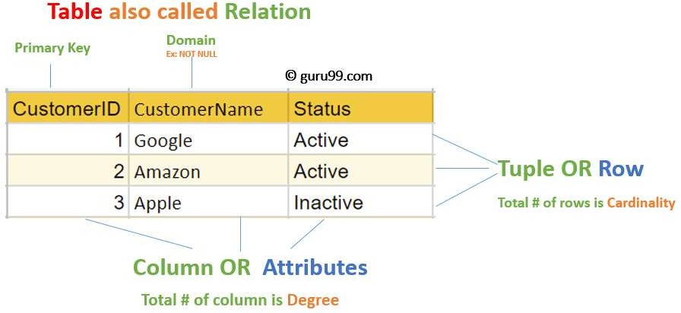
7

Slide 8
A DBMS Key is an attribute or set of attributes which helps us to identify a row (tuple) in a relation(table). It allows us to find the relation between two tables.
KEY
There are different types of keys:
Super Key
Unique Key
Primary Key
Candidate Key
Alternate Key
Foreign Key
8

Slide 9
SUPER KEY CANDIDATE KEY & NON-PRIME ATTRIBUTE
Super Key: A super key is a set of one or more attributes(columns), which can uniquely identify a row in a table.
Candidate Key: A super key with no redundant attribute is known as candidate key.
Non-prime Attribute: An attribute that is not part of any candidate key is known as non-prime attribute.
Emp_Id | Emp_Number | Emp_Name
E01 | 2264 | Steve
E02 | 2278 | John
E03 | 2288 | Martin
E04 | 2297 | Robert
Super Key:
Candidate Key:
{Emp_Id}
{Emp_Number}
{Emp_Id} {Emp_Number}
{Emp_Number} {Emp_Name}
{Emp_Id} {Emp_Name}
{Emp_Id} {Emp_Number} {Emp_Name}
{Emp_Id}
{Emp_Number}
Non-prime attribute
{Emp_Name}
10

Slide 10
UNIQUE KEY & PRIMARY KEY
A Unique key uniquely identifies each record in the database. This provides uniqueness for the column or set of columns and it can accept only one null value. Unique key is a subset of super key.
A primary key is a combination of fields which uniquely specify a row. This is a special kind of unique key, and it has implicit NOT NULL constraint. It means, Primary key values cannot be NULL.
A Primary key constraint has automatic unique constraint defined on it. But not, in the case of Unique Key.
Primary Key can be chosen from Candidate key.
There can be many unique constraint defined per table, but only
one Primary key constraint defined per table.
11

Slide 11
ALTERNATE KEY FOREIGN KEY
A candidate key, that is not a primary key is called an
Alternate key.
A non key attribute(or a group of non-key attributes) whose values are derived from primary key of some other table is known as Foreign key in its current table.
Foreign key is used to represent the relationship between two tables.
Foreign key of a table is a primary key of some other table.
12

Slide 12
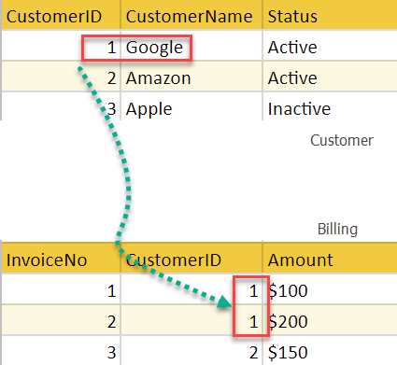
PRIMARY TABLE & FOREIGN TABLE
The table in which foreign key attribute exists, is called a
Foreign Table or Detail table.
The table that defines the primary key, which is the foreign key of the detail table or Foreign table refers to, is called Primary table or Master table.
Primary key
Primary table
Foreign Table
Foreign Table
13

Slide 13
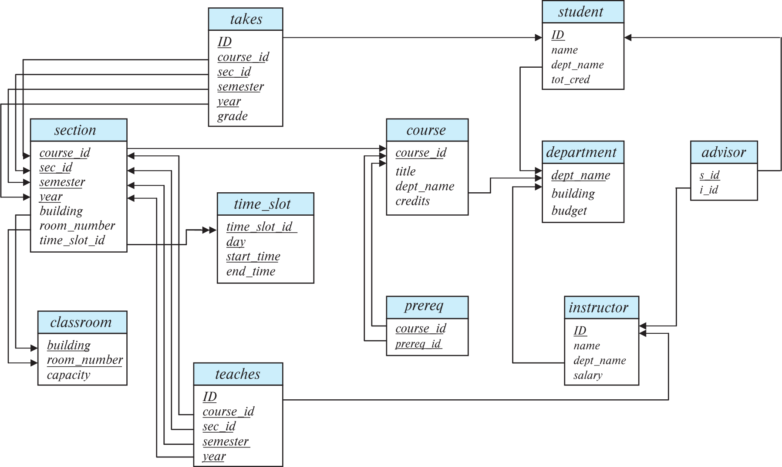
Schema Diagram for University Database

Slide 14










14

Slide 15
QUERY & SUB-QUERY
A DB query is a code written in order to get the information back from the database.
Query can be designed in such a way that it matched with our expectation of the result set. Simply, a question to the Database.
A sub-query is a query within another query. The outer query is called as main query, and inner query is called sub-query.
Sub-query is always executed first, and the result of sub-query is passed on to the main query.
There are two types of sub-query – Correlated and Non-Correlated.
A correlated sub-query cannot be considered as independent
query, but it can refer the column in a table listed in the FROM the list of the main query.
A Non-Correlated sub-query can be considered as independent query and the output of sub-query are substituted in the main query.
15

Slide 16








SQL is a language which is used to create & operate database.
SQL is the basic language used for all the databases.
SQL can be used by both casual users as well as skilled programmer.
There are minor syntax changes amongst different databases, but the
basic SQL syntax remains largely the same.
According to ANSI (American National Standards Institute), SQL is the
standard language to operate a relational database management system.
SQL is used in the accessing, updating, and manipulation of data in a database. Its design allows for the management of data in an RDBMS, such as MYSQL and PostgreSQL.
SQL language also used for controlling data access and for creation and modification of Database schemas.
16

Slide 17
1. Data Definition Language(DDL)
The SQL DDL provides commands for defining relation schemas, deleting relations, creating indexes and modifying relation schemas
2. Interactive Data Manipulation Language(DML)
The SQL DML includes a query language based on
both relational algebra and the tuple relational calculus. It includes the commands to insert, delete and modify tuples in the data base.
17

Slide 18
3. Embedded SQL
It is a method of combining the computing power of a programming language and the database manipulation capabilities of SQL.
View Definition
The SQL DDL also includes commands for defining views.(Views are the virtual tables that does not really exist in its own but is derived from one or more base table(s)).
Authorization
The SQL DDL also includes commands for specifying access rights to relation and views.
18

Slide 19








6. Integrity
The SQL provides limited forms of integrity checking. Future products and standards of SQL are likely to include enhanced features for integrity checking.
7. Transaction Control
SQL includes commands for specifying the beginning and ending of transactions along with the
commands to have a control over transaction processing.
19

Slide 20





)
A set of definitions which are expressed by a special language.
An ideal DDL should perform the following functions :
Identify the types of data
Give a unique name
Specify the proper data types
Specify how to record types are related to make structures.
Define the type of encoding the program uses in the data items
Define the length of data item.
Define the range of the values that a data item can assume
Specify means of checking for errors in the data.
Specify privacy locks.
Should not specify addressing, indexing or specify or searching techniques or specify the storage units.
Data dictionary is a file that contains metadata i.e. data about data.
20

Slide 21






Data Manipulation Language (DML) is a language that enables users to access or manipulate data as organized by the appropriate data model.
)
By data manipulation we mean
Retrieval
Insertion
Deletion
Modification

Slide 22








DML‟s are basically of two types:
)
Procedural DML
It requires a user to specify what data is needed and how to get it.
Non-procedural DML
It requires a user to specify what data is needed
without specifying how to get it.

Slide 23
SQL PROCESSING
SQL is a language oriented specifically around relational databases.
The SQL command can operate on entire groups of tables as a single object and can treat any quantity of information extracted or derived from them as a single unit as well.

Slide 24
Class | Data Type
Text | CHAR( or, CHARACTER)
Exact Numeric | DEC( or, DECIMAL)
 | NUMERIC
 | INT(or, INTEGER)
 | SMALLINT
Approximate Numeric | FLOAT
 | REAL
 | DOUBLE(or, DOUBLE PRECISION)
Date & Time
Currency

Slide 25
DATE & TIME
 |  | Date |  |  | Time
Standard | Full Form |  | Format | Example | Format | Example
ISO | International Organization for Standard |  | yyyy-mm-dd | 2020-03-15 | hh-mm-ss | 23-13-41
JIS | Japanese Industrial Standards |  | yyyy-mm-dd | 2020-03-15 | hh-mm-ss | 23-13-41
EUR | IBM European Standard |  | dd.mm.yyyy | 15.03.2020 | hh.mm.ss | 23.13.41
USA | IBM USA Standard |  | mm/dd/yyyy | 03/15/2020 | hh.mm AM/PM | 11.13 PM
TIME
DATE & TIME can be added subtracted or compared

Slide 26





VARIOUS SQL COMMANDS & FUNCTIONS
1. Keywords : The words that have a special meaning. SQL
keywords have been printed in capital letters.
e.g. NULL, UNIQUE, DEFAULT, CHECK, …etc.
Commands or Statements : Instructions to a SQL database
Clauses : Commands consist of one or more logically distinct
parts
Arguments : Modify the meaning of a clause
Objects : Structures in the database that are given names and stored in memory. They include base tables, views & indexes

Slide 27
SYMBOLS USED IN SYNTAX OF STATEMENT
Symbols |  | Meaning
| |  | or
{ | } | treated as a unit
[ | ] | everything enclosed in it is optional
… |  | repeated any number of times
…. |  | repeated any number of times with the individual occurrences separated by commas
< | > | SQL and other special terms are in angle brackets

Slide 28
RELATIONAL OPERATORS
Symbols | Meaning
= | equal to
> | greater than
< | less than
>= | greater equal to
<= | less equal to
<> | not equal to

Slide 29
References
Text Book: Database System Concepts, Sixth Edition, Abraham Silberschatz, Yale University Henry, F. Korth Lehigh University, S. Sudarshan Indian Institute of Technology, Bombay.

